Slide 1
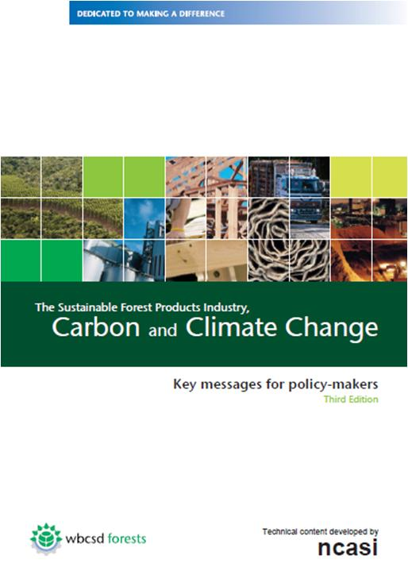
The Sustainable Forest Products Industry, Carbon and Climate Change
Key messages for policy-makers
Third Edition
October 2011

Slide 2
Executive summary for policy-makers
The Sustainable Forest Products Industry – Responsible managers of carbon
Our products have important environmental attributes
Our sustainable forest management practices support healthy growing forests
Much of our energy is supplied by sustainably produced biomass
We provide markets for wood, and creating incentives to keep land in forest
We are working with stakeholders on climate mitigation and adaptation.
Notes:
The Sustainable Forest Products Industry – Responsible managers of carbon
Our Product attributes include: the use of renewable raw materials, low fossil energy inputs, recyclability and carbon storage
Sustainable forest management provides the efficient infrastructure needed to support healthy growing forests and valuable ecosystem services.
We are energy intensive, but meet much of our energy needs with sustainably produced biomass
We provide markets for wood, and thus encourage landowners to retain or expand their forests.
We are working with stakeholders to maximize our contribution to climate mitigation and adaptation.

Slide 3
Executive summary for policy-makers
Our carbon opportunities
Our contributions can include;
Improved energy efficiencies and expanded use of CHP
More substitution of biomass for fossil fuel
Low-carbon products that substitute for more greenhouse gas intensive alternatives
Increased output of sustainably produced forest biomass
Increased recovery and use of recycled fiber
Expanded coverage of sustainable forest management systems
Notes:
Our carbon opportunities
Although the industry continues to reduce energy consumption, it is clear that major energy reductions will require breakthrough technologies
Nonetheless, even with current technologies, our contributions can be significant.
We can accomplish incremental improvement in energy efficiency and strive to expand our use of CHP
We can look for opportunities to further replace fossil fuels with biomass
We can continue to produce low-carbon products that not only store carbon but often substitute for more greenhouse gas intensive alternatives
We can meet societies demand for biomass by increase output of sustainably produced forest biomass and by partnering with stakeholders to increase recovery and use of recycled fiber
We can use our considerable knowledge and experience to assist in expanding the coverage of sustainable forest management systems

Slide 4
Executive summary for policy-makers
Our carbon challenges
The connections between our sector and the carbon cycle create are complex
We are highly capital intensive
Our sector is competitive and global.
We face increasing competition for our primary raw material
Notes:
Our carbon challenges
The complex connections between our sector and the carbon cycle create many opportunities for policies to have unintended consequences
Our capital intensity makes it difficult and expensive to change technology quickly
Our sector is competitive and global. We must think in terms of global solutions to business and environmental problems .
Mitigation strategies focusing only on biomass use will create competition for our primary raw material

Slide 5
Our policy recommendations
Sustainable forest management – the key strategy
Expand efforts to further bring the world’s forests under sustainable management
Develop local management capacity and support policy reform to reduce deforestation in developing countries as proposed by the REDD+ mechanism.
Notes:
Sustainable forest management is the key to our industry’s contributions to mitigation and adaptation
We recommend expanded efforts to further bring the world’s forests under sustainable management, making sure that it is done in a way that addresses the multiple and varied economic, social and ecological values and benefits of forests.
The reduce deforestation, support capacity building and policy reforms as called for under the REDD+ mechanism.

Slide 6
Our policy recommendations
Produce and use more wood on a sustainable basis – the key outcome
The many benefits of sustainable forest-based products and bio-energy can only be realized if public policies:
Promote adequate supplies;
Support forest owners;
Help minimize competition for the land;
Recognize carbon storage and substitution benefits;
Use fiber for products before using it as fuel
Notes:
The key outcome necessary for our industry to maximize its contributions to mitigation and adaptation is the ability to produce more wood-based products from sustainably produced wood.
This can only happen if public policies
Promote adequate supplies sustainably of produced wood;
Support forest owners by helping them keep land in forest, improve forest productivity, and increase residual recovery;
Help minimize competition for the land used to produce food, energy and industrial raw materials;
Recognize the climate benefits of carbon stored in products, and when substituted for more GHG-intensive alternatives;
Optimize fiber recovery and its use and re-use – as products first, and finally as a source of energy.

Slide 7
Our policy recommendations
Avoid counterproductive policy impacts and technology barriers – the key requirement
Mitigation or adaptation strategies should be market-driven.
Policies should expand the use of CHP and other low-GHG emitting technologies.
A level global playing field is critical
Notes:
We urge policy makers to strive to avoid counterproductive policy impacts and policies that erect barriers to development and deployment of technology
In specific,
Mitigation or adaptation strategies involving forest biomass should be market-driven, rather than relying on subsidies, incentives or mandates.
Policies should support the mitigation role of forest products manufacturers by helping them expand the use of CHP (Combined Heat and Power), invest in low-GHG emitting technologies, and facilitate the early adoption of these technologies.
A level global playing field in terms of carbon policy impacts will avoid carbon leakage.

Slide 8
Carbon benefits from forest products
The greenhouse gas intensities of many of our products are much lower than alternatives
Use of wood-based building materials avoids CO₂ emissions of 483 million tons per year
Our products store carbon
Equivalent to removing 424 million tons of CO₂ from the atmosphere per year
A market for wood keeps land in forest
North America and the EU account for 55% of global industrial wood harvesting yet forest carbon stocks in these regions are increasing

Slide 9
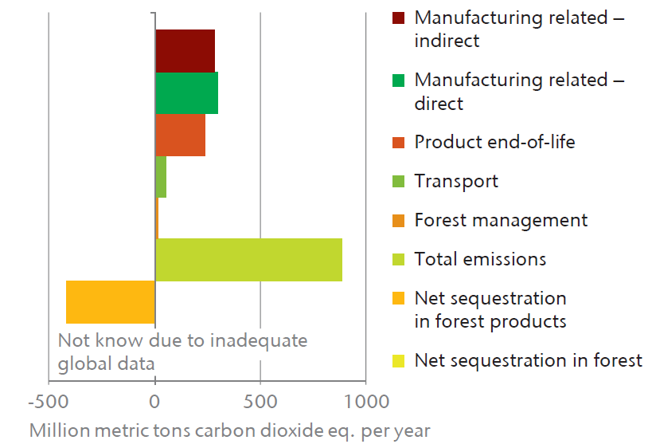
Carbon storage in products offsets a significant fraction of our value chain emissions

Slide 10
Sustainably managed forests are a renewable natural resource
Sustainable forest management practices;
Ensure continued carbon sequestration
Provide fiber for products
Protect ecological values in a balance way
Maintain healthy, vigorous, growing forests
A market for wood helps keep land in forest
Sustainably managed forests can compliment and extend environmental and biodiversity values
Sustainably managed forests sustain local communities

Slide 11
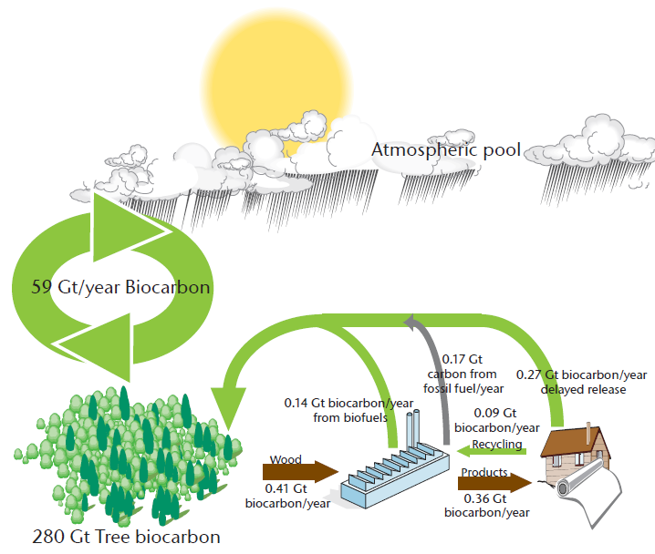
The forest biomass used by the forest sector affects only a small part of the carbon cycle

Slide 12
Sustainably managed forests provide wood fiber and carbon benefits
Managed forests provide GHG mitigation
Forest preservation carbon benefits are susceptible to reversal
The Kyoto Protocol fails to credit the forest sector with its contributions to mitigation via producing products that;
store carbon
replace more GHG-intensive alternatives
Notes:
Managed forests represent an effective mitigation mechanism that is already in place
Forest preservation may allow forests to become susceptible to natural disturbances
Forest biomass can be used in a number of ways to reduce emissions. Forest biomass can substitute for fossil fuels and can be used to produce products that store carbon and substitute for more carbon intensive alternatives in commerce. Under the Kyoto Protocol, however, the forest sector is not given credit for these reductions.

Slide 13
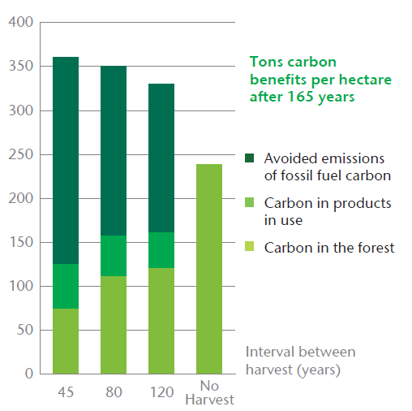
The carbon benefits of forest management are often greater than forest preservation
Managed forests in the Pacific Northwest of the U.S. yield greater carbon benefits when harvesting intervals are reduced to increase the production of building products

Slide 14
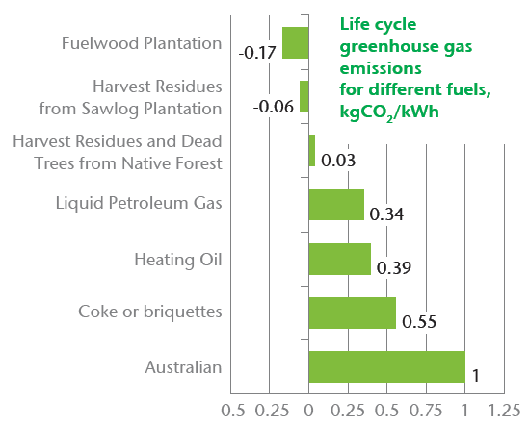
Planting new forests can result in products with net negative emissions
Plantations established on non-forested lands in Australia produce wood for heating having net GHG emissions that are less than zero.

Slide 15
The industry is highly resource efficient
A highly efficient forest biomass infrastructure
Essentially all material removed from the forest is used
In 2007, wood was used 34% more efficiently than in 1990.
We rely extensively on combined heat and power (CHP) systems
Notes:
The industry supports a highly efficient biomass collection and transport infrastructure
Essentially all material removed from the forest is used for products or energy
The industry obtained 34% more product from every cubic meter of harvested wood in 2007 than it did in 1990. This was made possible by;
increasing the recovery and use of recycled fiber
new products making more efficient use of fiber
The forest products industry is among the leaders in using highly efficient combined heat and power (CHP) systems

Slide 16
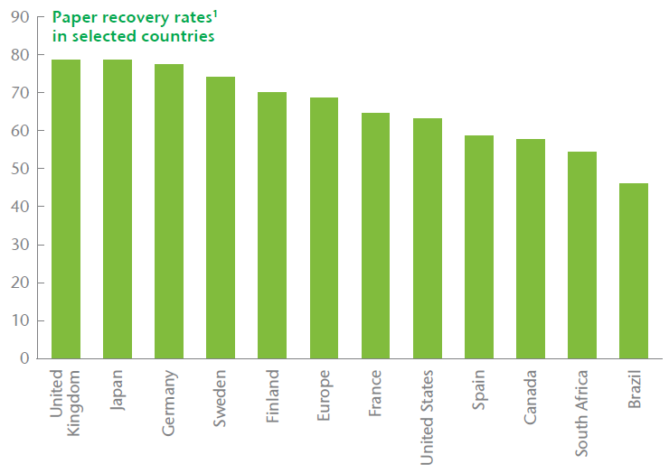
The recycling rates for paper are higher than for any other material
¹ Because data sources and definitions vary, comparisons between countries
must be made with caution

Slide 17
Energy consumption in the forest-based industry
The paper industry is energy intensive but;
obtains much of its energy from sustainably produced biomass
has dramatically improved its energy efficiency over time
Wood products require less energy to produce than alternative products
In total, the industry’s CO₂ emissions related to consumption of fossil fuels and electricity amount to 1.6% of global CO₂ emissions

Slide 18
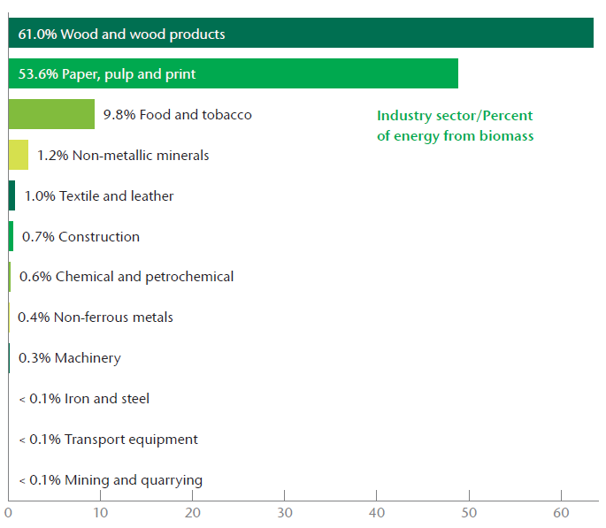
The forest products industry is the leader in the use of biomass fuels to meet energy requirements

Slide 19
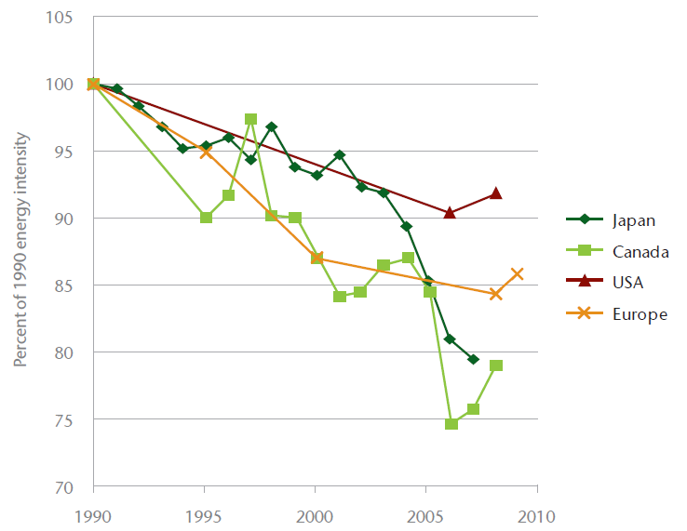
The industry has a record of reducing energy intensity
Energy intensity has been reduced by approximately 10 to 20 percent since 1990.
Recent upturns are due to lower operating rates, attributable to the global economic slowdown.

Slide 20
Our Carbon Opportunities
Further increase the use of CHP
Further increase fiber recovery and reuse
Produce more wood-based building materials
Develop new forest-based products
Develop breakthrough manufacturing technologies
Increase supplies of forest biomass
extend the reach of sustainable forest management
Support REDD+
Notes:
The use of highly efficient CHP systems could be increased from already high levels
The recovery and use of recycled fiber can be increased from already high levels
Producing more wood-based building materials can reduce societal GHG emissions by replacing more GHG intensive alternatives
New forest-based products can be developed, expanding the mitigation opportunities for low carbon products
Breakthrough technologies may greatly reduce the energy needs and GHG emissions associated with manufacturing
Supplies of forest biomass can be increased by investing in forest productivity improvements
The industry can continue to work to expand the reach of sustainable forest management programs
WBCSD supports the design and implementation of REDD+ policies and funding mechanisms;
Designed to catalyze and support a full range of forest management options
Flexible enough to address specific and significant causes of deforestation in individual countries
Based on a phased approach leading to performance-based payments
Including social, environmental and financial safeguards
Involving indigenous peoples, forest communities and private sector stakeholders
Informed by the experiences from the voluntary carbon markets

Slide 21
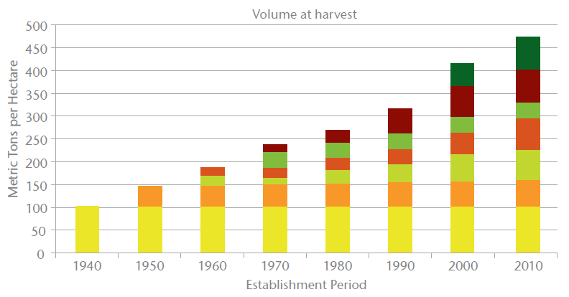
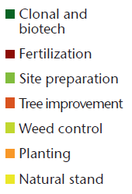
Enhanced forest productivity yields substantial benefits
A variety of intensive management practices have resulted in dramatic increases
in the productivity of pine plantations in the Southern United States

Slide 22
A commitment to continuous improvement: Energy and GHGs
Europe: Goal to increase biomass use to 56% of onsite consumption
U.S.: Goal to reduce GHG intensity by 15% and energy intensity by 10%
Canada: Reduced GHG emissions by 57% between 1990 and 2009
Japan: Goal to reduce fossil energy consumption by 20% and CO₂ emissions by 16%
Notes:
In 2003, the European pulp and paper industry set a goal of increasing biomass use to 56% of total onsite primary energy consumption by 2010. The most recent data indicate that the industry is on track to meet this goal.
In 2011, AF&PA expanded an earlier greenhouse gas reduction goal, committing to reducing greenhouse gas intensity by 15% by 2020 compared to 2005 levels. In addition, AF&PA committed to reducing purchased energy intensity by 10% over the same period.
Canada’s pulp and paper sector cut greenhouse gas emissions by 57% during the 1990-2009 period, while reducing emissions intensity by 60%.
In 2008, the Japan Paper Association committed to reducing the five-year average fossil energy consumption per ton by 20% and related CO2 emissions by 16% from 1990 levels by 2012.

Slide 23
A commitment to continuous improvement: Recycling
Japan: Goal to achieve a recovered fiber utilization rate of 64%
U.S.: Goal to increase the paper recovery rate to exceed 70%
Europe: Exceeded 66% recycling rate target. New goal being developed
Canada: Goal to increase recovery rate by 25% (to a rate of 55%)
Notes:
The Japan Paper Association has committed to achieve a recovered fiber utilization rate of 64% by 2015.
In March 2011, AF&PA announced a goal to increase the paper recovery rate to exceed 70% by 2020.
The 2010 European paper recycling rate of 68.9% was higher than the 66% target set by the European paper industry for 2006-2010. The European Recovered Paper Council is preparing a new, ambitious commitment for 2011-2015, to further increase paper recycling.
In 2003, the Forest Products Association of Canada established a goal of a 25% increase in recovery rates by 2012. That would increase the recovery rate to 55%

Slide 24
Our Carbon Challenges
Policies that discourage harvesting to keep carbon in the forest
Policies that fail to address biomass supply
Long investment horizons and uncertain returns
Highly capital intensive
A global and highly competitive industry
Notes:
Policies that encourage accumulation of carbon in the forest via reduced harvesting…
will increase the industry’s costs for wood
will increase the market share of alternative products having higher GHG intensity
may increase the risk of natural disturbances
Biomass energy policies that fail to address biomass supplies…
will increase industry’s costs for wood
will increase the market share of alternative products having higher GHG intensity
will threaten the viability of the forest products industry, which provides more economic and social benefits than operations that merely burn fiber for energy
Forestry is challenged with very long investment horizons and uncertain returns
To keep land in forest, it is critical to understand the factors influencing land use decisions and land values
Forest products manufacturing is very capital intensive and equipment is long-lived
Major equipment is expected to last 25+ years
The industry is global and highly competitive
A level international playing field is critical

Slide 25
Cross-sector elements necessary to enhance investments and sales of low-carbon technologies
Strong signals from government
Adequate institutional frameworks
Appropriate absorptive capacity
Bridging economic and financial incentives
Energy efficiency drivers
Technology diffusion alliances
Notes:
Strong signals from government toward low carbon growth
Adequate institutional frameworks providing stable policies and investment climate
Appropriate absorptive capacity in institutions, business and society
Economic and financial incentives to bridge the gap to commercial viability
Energy efficiency drivers, removing barriers to improved performance
Business engagement with governments to enhance technology diffusion

Slide 26
Additional enabling elements of special significance to the forest products industry
Encourage sustainable forest management
Reward forest-based ecological services
Eliminate perverse subsidies
Develop and deploy breakthrough technologies
Remove barriers to CHP
Expand procurement policies
Promote capital stock turnover
Notes:
Encouraging the practice of sustainable forest management
Recognizing and rewarding forest-based ecological services, including carbon sequestration
Eliminating perverse subsidies
Developing and deploying biomass based breakthrough technologies
Removing barriers to increasing CHP use
Expanding public and private sector procurement policies for forest-based products
Promoting faster turnover of capital stock

Slide 27
Public policy alerts
Consider economic and employment impacts
Wood for energy vs. wood for products
Wood supply issues are critical
Mandates and incentives distort the market
It is important to keep land in forest
Notes:
Climate policies also must consider economic and employment impacts
Using wood for forest products yields greater value added and employment than using wood for energy
Uncertainties about the adequacy of future supplies of wood create challenges to investment in sustainable forest management and forest products manufacturing
Policy makers must strive to avoid mandates and incentives that distort the market for wood
Policies should help keep land in forest and strive to ensure adequate future supplies of wood

Slide 28
Policy recommendations
The context
Biomass from sustainably managed forests has significant mitigation value
Policies must consider life cycle impacts, not just what happens in the forest
The industries contributions can be expanded, given appropriate policies
Notes:
The context
Biomass from sustainably managed forests is a low-impact, renewable raw material and biomass energy source.
Efficient and effective long term GHG mitigation policies must consider the emissions profile of a product over its entire life cycle.
The industry can make significant contributions toward the world’s mitigation and adaptation goals, if certain policy recommendations are effectively implemented.

Slide 29
Policy recommendations
Sustainable forest management – the key strategy
Intensify efforts to extend sustainable forest management practices
Reduce deforestation via market mechanisms and mechanisms like those in REDD+
Notes:
Sustainable forest management – the key strategy
Efforts to extend sustainable forest management practices to more of the world’s forests should be intensified, recognizing forests’ multiple environmental, economic and societal values.
Policies are needed to reduce deforestation and encourage afforestation and the use of active, sustainable forest management. Policies should be based on the facilitation of markets for forest products, market incentives and improved management systems. Development aid to build local capacity and support policy reform will often be necessary ,as proposed under the REDD+.

Slide 30
Policy recommendations
Produce and use more wood on a sustainable basis – the key outcome
Policies should promote adequate supplies of wood and recovered fiber.
First use forest biomass to make products, and then recycle before using the fiber for energy.
Recognize the benefits of carbon in products and substitution effects
Notes:
Produce and use more wood on a sustainable basis – the key outcome
The benefits of our products can only be realized if public policies promote adequate supplies of wood and recovered fiber. Policies should support landowner efforts to keep land in forest, improve productivity, and increase the recovery of biomass. Manufacturers can assist by generating wood-derived co-products.
Within a market-driven framework, policies should recognize the environmental and economic benefits of first using forest biomass make products, and then recycling before using the material as a source of energy.
Policies should recognize the benefits of carbon stored in forest products and the carbon and energy attributes of forest products, compared to competing products.

Slide 31
Policy recommendations
Avoid counterproductive policy impacts and technology barriers – the key requirement
Avoid subsidies, incentives and mandates and consider land competition
Look beyond forest-based carbon sequestration
Remove barriers to increased use of CHP
Facility development and deployment of new technologies
Help reduce the cost of capital
Seek a level global playing field
Notes:
Avoid counterproductive policy impacts and technology barriers – the key requirement
Market forces, rather than subsidies, incentives or mandates, should determine the use of biomass. Sustainable production of all types of biomass should be encouraged to minimize competition for land.
The unintended consequences of forest-based carbon sequestration should be carefully considered. These consequences include the loss of wood-producing forests, artificial pricing of forest resources, and declining forest health.
Regulatory and non-regulatory barriers that discourage facilities from maximizing CHP potential should be removed.
Policies should enable the development and deployment of new technologies to make our industry energy self-sufficient, and a supplier of bio-based energy.
Government policies that help reduce the cost of capital will facilitate the adoption of technologies that reduce emissions.
A level global playing field, with respect to the impacts of carbon policies, is necessary in order to avoid carbon leakage.

Slide 32
For more information
James Griffiths
Managing Director
Ecosystems, Water and Sustainable Forest Products Industry
T: +41 (0) 22 839 31 14
M: +41 (0) 79 291 62 40
E: griffiths@wbcsd.org
Download this report from www.wbcsd.org or use this link
Use this link to specific policy recommendations on Harvested Wood Products (HWP) climate mitigation and adaptation benefits

