Slide 1
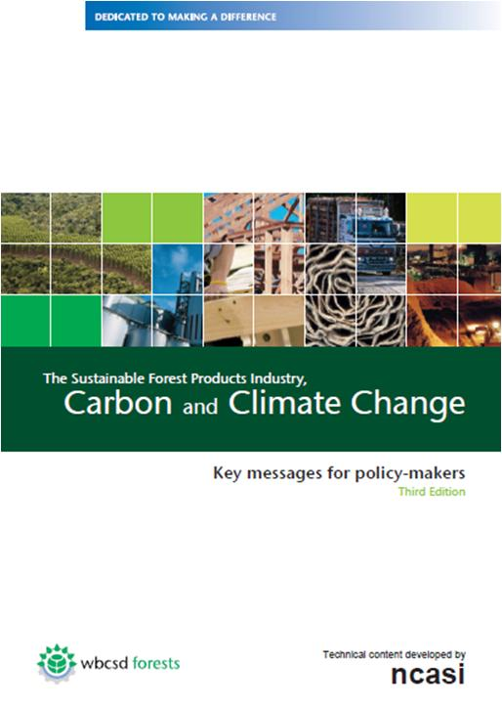
The Sustainable Forest Products Industry, Carbon and Climate Change
Key messages for policy-makers
Third Edition
October 2011

Slide 2
Executive summary for policy-makers
The Sustainable Forest Products Industry – Responsible managers of carbon
Product attributes include: renewable raw materials, low fossil energy inputs, highly recyclable, carbon storage
Sustainable forest management provides the efficient infrastructure needed to support healthy growing forests and valuable ecosystem services.
We are energy intensive, but meet much of our energy needs with sustainably produced biomass
We provide markets for wood, and thus encourage landowners to retain or expand their forests.
We are working with stakeholders to maximize our contribution to climate mitigation and adaptation.

Slide 3
Executive summary for policy-makers
Our carbon opportunities
Major energy reductions will require breakthrough technologies
Our contributions can include;
Improved energy efficiencies and additional use of CHP
More substitution of biomass for fossil fuel
Produce low-carbon products that substitute for more greenhouse gas intensive alternatives
Increase output of sustainably produced forest biomass
Increase recovery and use of recycled fiber
Assist in expanding the coverage of sustainable forest management systems

Slide 4
Executive summary for policy-makers
Our carbon challenges
The complex connections between our sector and the carbon cycle create many opportunities for policies to have unintended consequences
Our capital intensity makes it difficult and expensive to change technology quickly
Our sector is competitive and global. We must think in terms of global solutions to business and environmental problems .
Mitigation strategies focusing only on biomass use will create competition for our primary raw material

Slide 5
Our policy recommendations
Sustainable forest management – the key strategy
Expand efforts to further bring the world’s forests under sustainable management, accommodating the multiple and varied economic, social and ecological values and benefits of forests.
Develop local management capacity and support policy reform to reduce deforestation in developing countries as proposed by the REDD+ mechanism.

Slide 6
Our policy recommendations
Produce and use more wood on a sustainable basis – the key outcome
The many benefits of sustainable forest-based products and bio-energy can only be realized if public policies:
Promote adequate supplies sustainably produced wood;
Support forest owners by helping them keep land in forest, improve forest productivity, and increase residual recovery;
Help minimize competition for the land used to produce food, energy and industrial raw materials;
Recognize the climate benefits of carbon stored in products, and when substituted for more GHG-intensive alternatives;
Optimize fiber recovery and its use and re-use – as products first, and finally as a source of energy.

Slide 7
Our policy recommendations
Avoid counterproductive policy impacts and technology barriers – the key requirement
Mitigation or adaptation strategies involving forest biomass should be market-driven, rather than relying on subsidies, incentives or mandates.
Policies should support the mitigation role of forest products manufacturers by helping them expand the use of CHP (Combined Heat and Power), invest in low-GHG emitting technologies, and facilitate the early adoption of these technologies.
A level global playing field in terms of carbon policy impacts will avoid carbon leakage.

Slide 8
Carbon benefits from forest products
The greenhouse gas intensities of many of our products are much lower than alternatives
Use of wood-based building materials avoids CO₂ emissions of 483 million tons per year
Our products store carbon
Equivalent to removing 424 million tons of CO₂ from the atmosphere per year
A market for wood keeps land in forest
North America and the EU account for 55% of global industrial wood harvesting yet forest carbon stocks in these regions are increasing

Slide 9
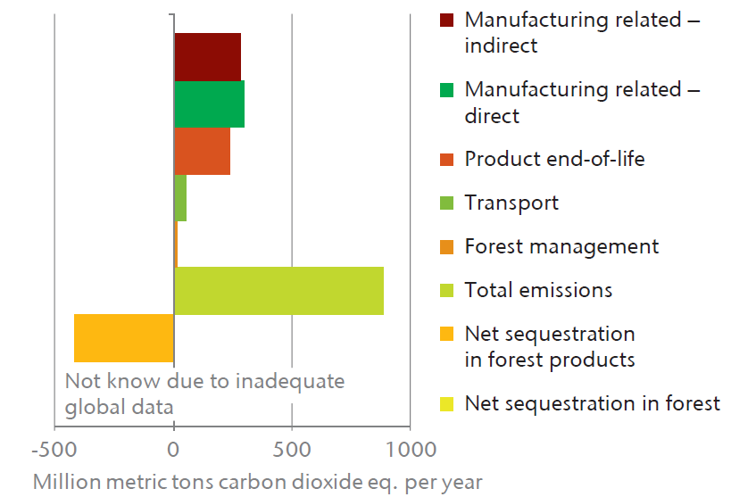
Carbon storage in products offsets a significant fraction of our value chain emissions

Slide 10
Sustainably managed forests are a renewable natural resource
Sustainable forest management practices;
Ensure continued carbon sequestration
Provide fiber for products
Protect ecological values in a balance way
Maintain healthy, vigorous, growing forests
A market for wood helps keep land in forest
Sustainably managed forests can compliment and extend environmental and biodiversity values
Sustainably managed forests sustain local communities

Slide 11
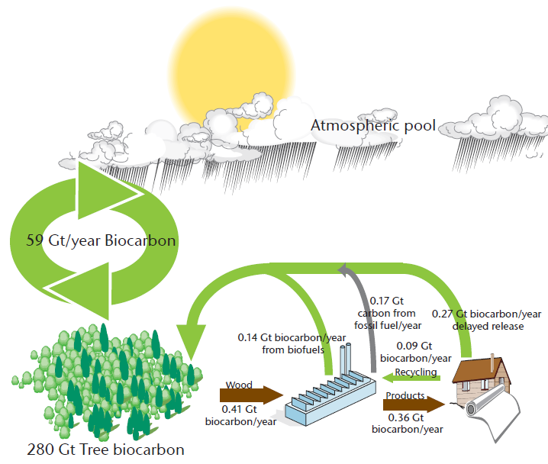
The forest biomass used by the forest sector affects only a small part of the carbon cycle

Slide 12
Sustainably managed forests provide wood fiber and carbon benefits
Managed forests represent an effective mitigation mechanism that is already in place
Forest preservation may allow forests to become susceptible to natural disturbances
The Kyoto Protocol fails to credit the forest sector with its contributions to mitigation via producing products that;
store carbon, reducing the amounts in the atmosphere
can substitute for more GHG-intensive products in commerce

Slide 13
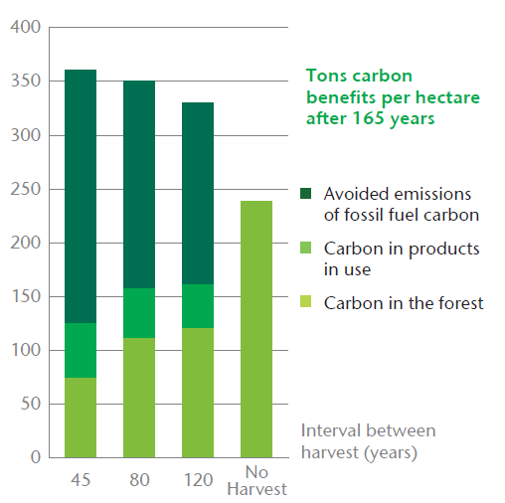
The carbon benefits of forest management are often greater than forest preservation
Managed forests in the Pacific Northwest of the U.S. yield greater carbon benefits when harvesting intervals are reduced to increase the production of building products

Slide 14
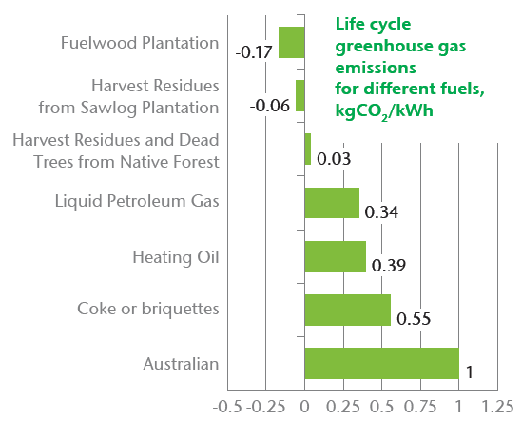
Planting new forests can result in products with net negative emissions
Plantations established on non-forested lands in Australia produce wood for heating having net GHG emissions that are less than zero.

Slide 15
The industry is highly resource efficient
The industry supports a highly efficient biomass collection and transport infrastructure
Essentially all material removed from the forest is used for products or energy
The industry obtained 34% more product from every cubic meter of harvested wood in 2007 than it did in 1990. This was made possible by;
increasing the recovery and use of recycled fiber
new products making more efficient use of fiber
The forest products industry is among the leaders in using highly efficient combined heat and power (CHP) systems

Slide 16
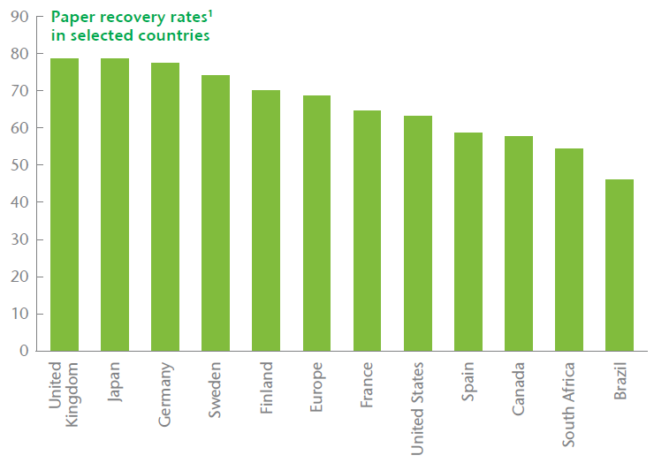
The recycling rates for paper are higher than for any other material
¹ Because data sources and definitions vary, comparisons between countries must be made with caution

Slide 17
Energy consumption in the forest-based industry
The paper industry is energy intensive but;
obtains much of its energy from sustainably produced biomass
has dramatically improved its energy efficiency over time
Wood products require less energy to produce than alternative products
In total, the industry’s CO₂ emissions related to consumption of fossil fuels and electricity amount to 1.6% of global CO₂ emissions

Slide 18
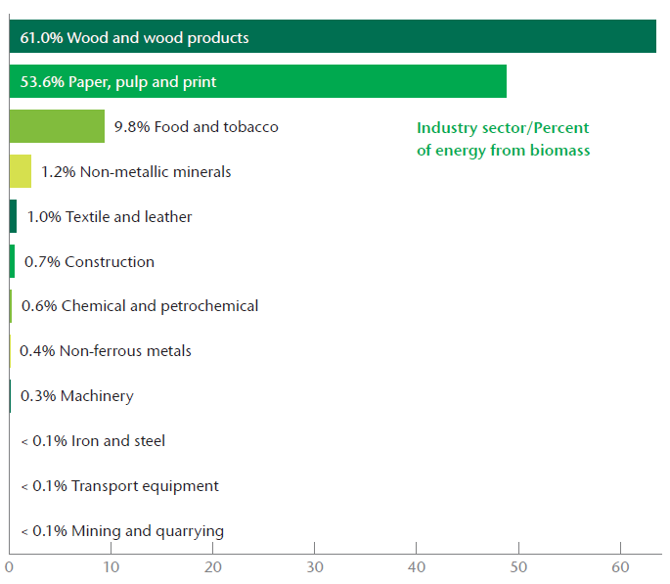
The forest products industry is the leader in the use of biomass fuels to meet energy requirements

Slide 19
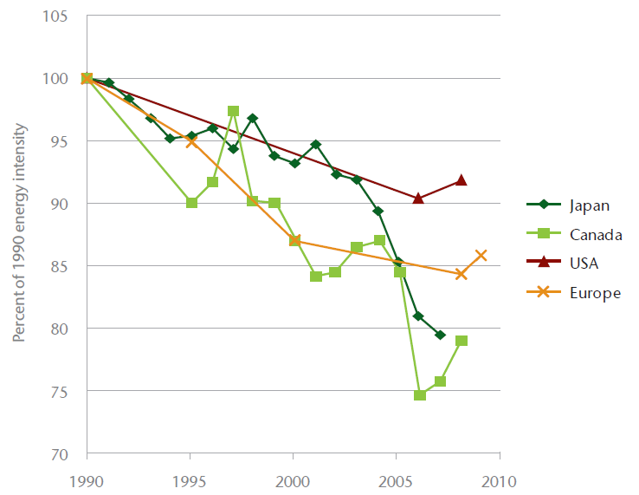
The industry has a record of reducing energy intensity
Energy intensity has been reduced by approximately 10 to 20 percent since 1990.
Recent upturns are due to lower operating rates, attributable to the global economic slowdown.

Slide 20
Our Carbon Opportunities - 1
The use of highly efficient CHP systems could be increased from already high levels
The recovery and use of recycled fiber can be increased from already high levels
Producing more wood-based building materials can reduce societal GHG emissions by replacing more GHG intensive alternatives
New forest-based products can be developed, expanding the mitigation opportunities for low carbon products

Slide 21
Our Carbon Opportunities - 2
Breakthrough technologies may greatly reduce the energy needs and GHG emissions associated with manufacturing
Supplies of forest biomass can be increased by investing in forest productivity improvements
The industry can continue to work to expand the reach of sustainable forest management programs

Slide 22
Our Carbon Opportunities - 3
WBCSD supports the design and implementation of REDD+ policies and funding mechanisms;
Designed to catalyze and support a full range of forest management options
Flexible enough to address specific and significant causes of deforestation in individual countries
Based on a phased approach leading to performance-based payments
Including social, environmental and financial safeguards
Implemented by the proactive involvement of indigenous peoples, forest communities and private sector stakeholders
Informed by the experiences from the voluntary carbon markets

Slide 23
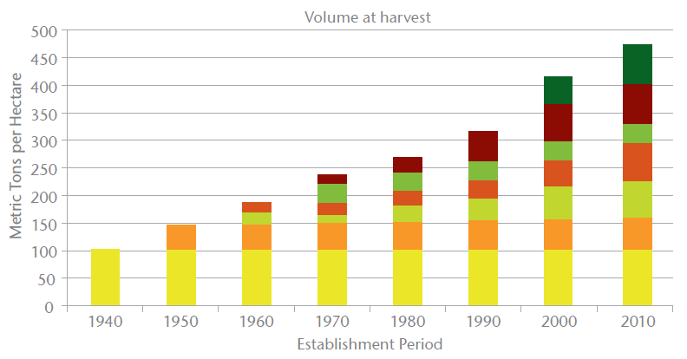
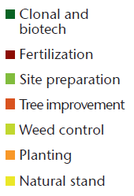
Enhanced forest productivity yields substantial benefits
A variety of intensive management practices have resulted in dramatic increases
in the productivity of pine plantations in the Southern United States

Slide 24
A commitment to continuous improvement: Energy and GHGs
In 2003, the European pulp and paper industry set a goal of increasing biomass use to 56% of total onsite primary energy consumption by 2010. The most recent data indicate that the industry is on track to meet this goal.
In 2011, AF&PA expanded an earlier greenhouse gas reduction goal, committing to reducing greenhouse gas intensity by 15% by 2020 compared to 2005 levels. In addition, AF&PA committed to reducing purchased energy intensity by 10% over the same period.
Canada’s pulp and paper sector cut greenhouse gas emissions by 57% during the 1990-2009 period, while reducing emissions intensity by 60%.
In 2008, the Japan Paper Association committed to reducing the five-year average fossil energy consumption per ton by 20% and related CO2 emissions by 16% from 1990 levels by 2012.

Slide 25
A commitment to continuous improvement: Recycling
The Japan Paper Association has committed to achieve a recovered fiber utilization rate of 64% by 2015.
In March 2011, AF&PA announced a goal to increase the paper recovery rate to exceed 70% by 2020.
The 2010 European paper recycling rate of 68.9% was higher than the 66% target set by the European paper industry for 2006-2010. The European Recovered Paper Council is preparing a new, ambitious commitment for 2011-2015, to further increase paper recycling.
In 2003, the Forest Products Association of Canada established a goal of a 25% increase in recovery rates by 2012. That would increase the recovery rate to 55%.

Slide 26
Our Carbon Challenges - 1
Policies that encourage accumulation of carbon in the forest via reduced harvesting…
will increase the industry’s costs for wood
will increase the market share of alternative products having higher GHG intensity
may increase the risk of natural disturbances

Slide 27
Our Carbon Challenges - 2
Biomass energy policies that fail to address biomass supplies…
will increase industry’s costs for wood
will increase the market share of alternative products having higher GHG intensity
will threaten the viability of the forest products industry, which provides more economic and social benefits than operations that merely burn fiber for energy

Slide 28
Our Carbon Challenges - 3
Forestry is challenged with very long investment horizons and uncertain returns
To keep land in forest, it is critical to understand the factors influencing land use decisions and land values
Forest products manufacturing is very capital intensive and equipment is long-lived
Major equipment is expected to last 25+ years
The industry is global and highly competitive
A level international playing field is critical

Slide 29
Cross-sector elements necessary to enhance investments and sales of low-carbon technologies
Strong signals from government toward low carbon growth
Adequate institutional frameworks providing stable policies and investment climate
Appropriate absorptive capacity in institutions, business and society
Economic and financial incentives to bridge the gap to commercial viability
Energy efficiency drivers, removing barriers to improved performance
Business engagement with governments to enhance technology diffusion

Slide 30
Additional enabling elements of special significance to the forest products industry
Encouraging the practice of sustainable forest management
Recognizing and rewarding forest-based ecological services, including carbon sequestration
Eliminating perverse subsidies
Developing and deploying biomass based breakthrough technologies
Removing barriers to increasing CHP use
Expanding public and private sector procurement policies for forest-based products
Promoting faster turnover of capital stock

Slide 31
Public policy alerts
Climate policies also must consider economic and employment impacts
Using wood for forest products yields greater value added and employment than using wood for energy
Uncertainties about the adequacy of future supplies of wood create challenges to investment in sustainable forest management and forest products manufacturing
Policy makers must strive to avoid mandates and incentives that distort the market for wood
Policies should help keep land in forest and strive to ensure adequate future supplies of wood

Slide 32
Policy recommendations
The context
Biomass from sustainably managed forests is a low-impact, renewable raw material and biomass energy source.
Efficient and effective long term GHG mitigation policies must consider the emissions profile of a product over its entire life cycle.
The industry can make significant contributions toward the world’s mitigation and adaptation goals, if certain policy recommendations are effectively implemented.

Slide 33
Policy recommendations
Sustainable forest management – the key strategy
Efforts to extend sustainable forest management practices to more of the world’s forests should be intensified, recognizing forests’ multiple environmental, economic and societal values.
Policies are needed to reduce deforestation and encourage afforestation and the use of active, sustainable forest management. Policies should be based on the facilitation of markets for forest products, market incentives and improved management systems. Development aid to build local capacity and support policy reform will often be necessary ,as proposed under the REDD+.

Slide 34
Policy recommendations
Produce and use more wood on a sustainable basis – the key outcome
The benefits of our products can only be realized if public policies promote adequate supplies of wood and recovered fiber. Policies should support landowner efforts to keep land in forest, improve productivity, and increase the recovery of biomass. Manufacturers can assist by generating wood-derived co-products.
Within a market-driven framework, policies should recognize the environmental and economic benefits of first using forest biomass make products, and then recycling before using the material as a source of energy.
Policies should recognize the benefits of carbon stored in forest products and the carbon and energy attributes of forest products, compared to competing products.

Slide 35
Policy recommendations
Avoid counterproductive policy impacts and technology barriers – the key requirement
Market forces, rather than subsidies, incentives or mandates, should determine the use of biomass. Sustainable production of all types of biomass should be encouraged to minimize competition for land.
The unintended consequences of forest-based carbon sequestration should be carefully considered. These consequences include the loss of wood-producing forests, artificial pricing of forest resources, and declining forest health.
Regulatory and non-regulatory barriers that discourage facilities from maximizing CHP potential should be removed.

Slide 36
Policy recommendations
Avoid counterproductive policy impacts and technology barriers – the key requirement (cont.)
Policies should enable the development and deployment of new technologies to make our industry energy self-sufficient, and a supplier of bio-based energy.
Government policies that help reduce the cost of capital will facilitate the adoption of technologies that reduce emissions.
A level global playing field, with respect to the impacts of carbon policies, is necessary in order to avoid carbon leakage.

Slide 37
For more information
James Griffiths
Managing Director
Ecosystems, Water and Sustainable Forest Products Industry
T: +41 (0) 22 839 31 14
M: +41 (0) 79 291 62 40
E: griffiths@wbcsd.org
Download this report from www.wbcsd.org or use this link
Use this link to specific policy recommendations on Harvested Wood Products (HWP) climate mitigation and adaptation benefits

